Slide 1

Still View Controller
(SVC)
Electronic Motion-Adaptive
Image or Triggers Override System
(Hardware and/or Software)
Copyright © 2014 LLC, 2011

Slide 2
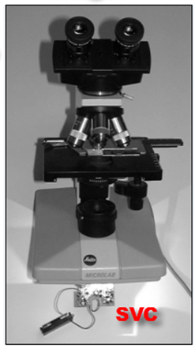
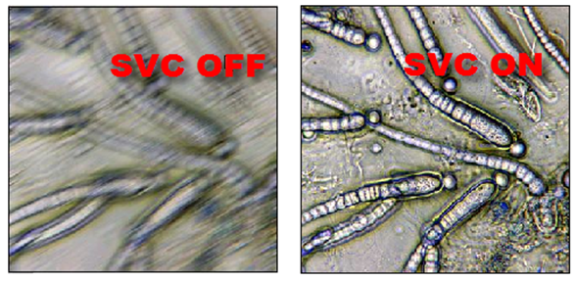
Real-time Optical microscopy Application
for vibration blur removal

Slide 3
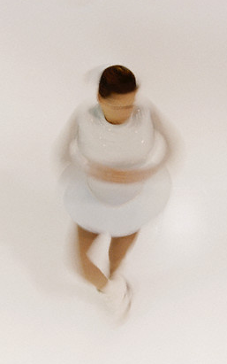
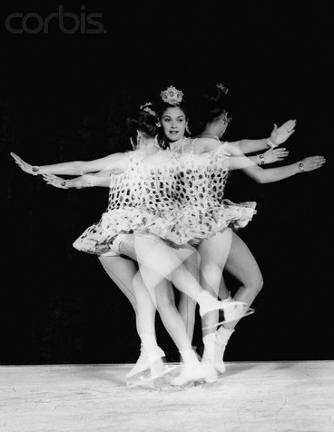
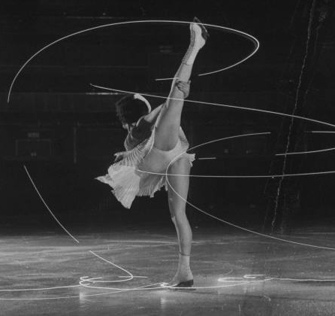
Principle
Adaptive Strobe

Slide 4
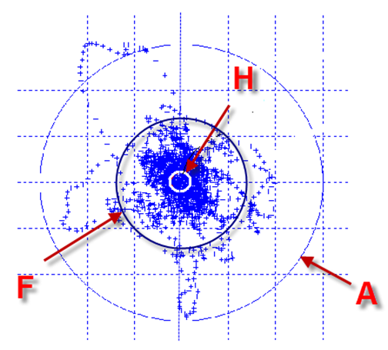
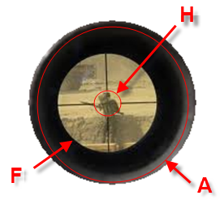
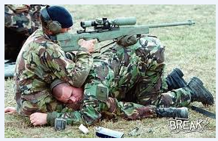
Trigger Override Application
Triggered within F, hits inside H.
Inactive outside A.

Slide 5
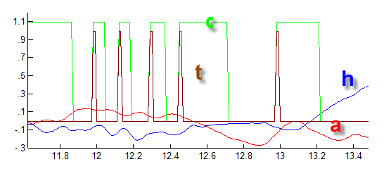
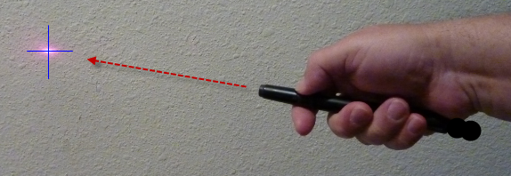
How it works?
(ε=R_{H}² ) > (h²+a²)^{1/2}
Still Pointer

Slide 6
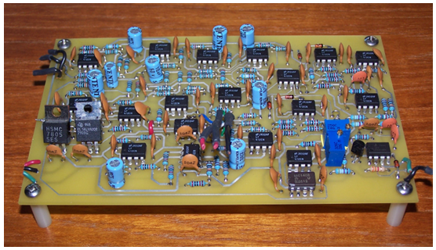

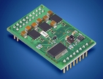
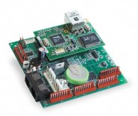
Generic SVC Controllers
Pass images upon same position and
Freeze/block/morph/stash in between.

Slide 7
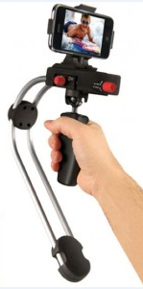
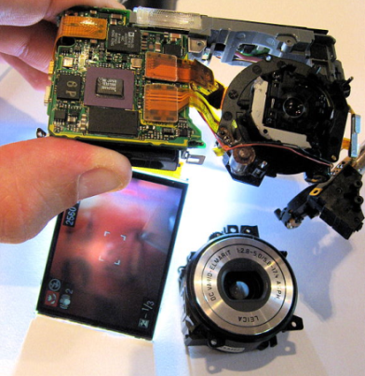
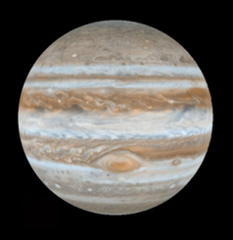
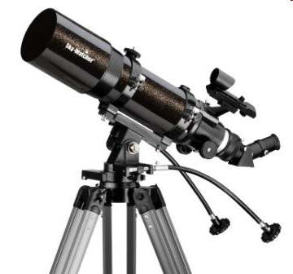
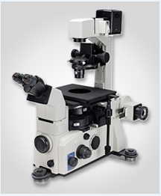
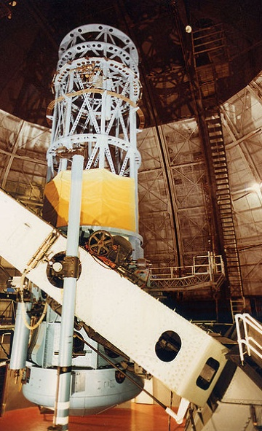
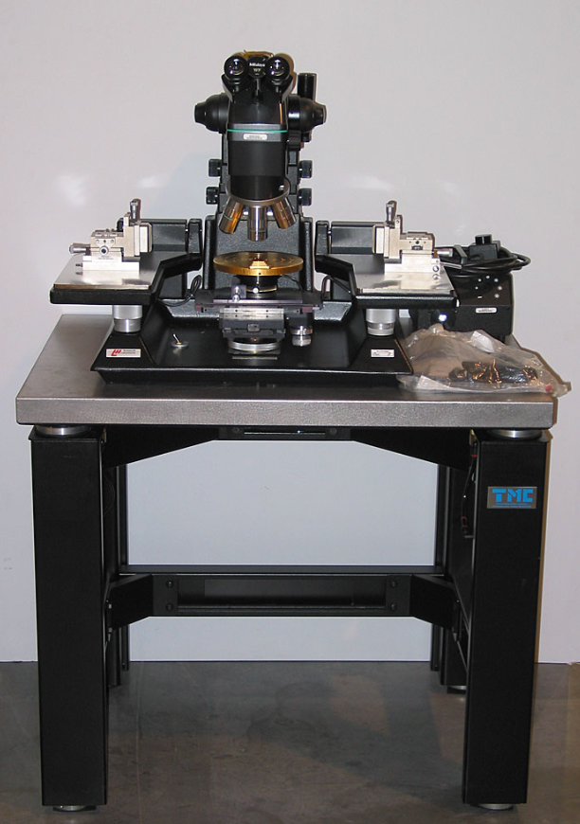

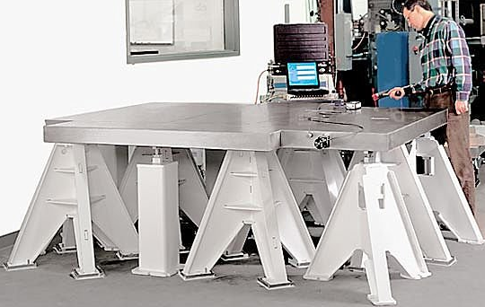
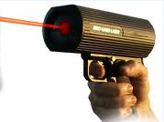
Fields-of-Application

Slide 8
Field of Licensing
Microscopy (amateur & professional)
Telescopy (amateur & professional)
Photography (still & video cameras)
Holography (real-time & post-processing)
Cinematography (movies & special effects)
Semicon Mfg. (etching & imaging & measures)
Healthcare (laser surgery and diagnostics)
Commerce (bar-code & bokode readings)
Military (laser weaponry & gunnery)
Education (pointer & video games training)

Slide 9
Market Cap
Microscopy $ 1 B
Telescopy $ 1 B
Still Cameras $ 1 B
Video cameras $ 1 B
Other EIS/OIS $ 3 B
$ 7 B

Slide 10
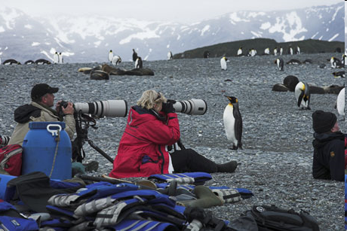

Wherever you shoot, enjoy it!
Copyright © 2014 LLC, 2011

